Slide 1
Common Algorithms of Machine Learning

Slide 2
Disease detection with the Cassava plant

Slide 3
Introduction
Artificial Intelligence has become prevalent recently.
People across different disciplines are trying to apply AI to make their tasks a lot easier.
For example, economists are using AI to predict future market prices to make a profit.
Doctors use AI to classify whether a tumor is malignant or benign.
Meteorologists use AI to predict the weather.
HR recruiters use AI to check the resume of applicants to verify if the applicant meets the minimum criteria for the job, etc.
The impetus behind such ubiquitous use of AI is machine learning algorithms

Slide 4
What is Machine Learning?
“Learning is any process by which a system improves
performance from experience.”
- Herbert Simon
“Field of study that gives computers the ability to learn without being explicitly programmed.”
- Arthur Samuel (1959).
Definition by Tom Mitchell (1998):
Machine Learning is the study of algorithms that
improve their performance P
at some task T
with experience E.
A well-defined learning task is given by <P, T, E>.
Example:
T: Categorize email messages as spam or legitimate.
P: Percentage of email messages correctly classified.
E: Database of emails, some with human-given labels

Slide 5
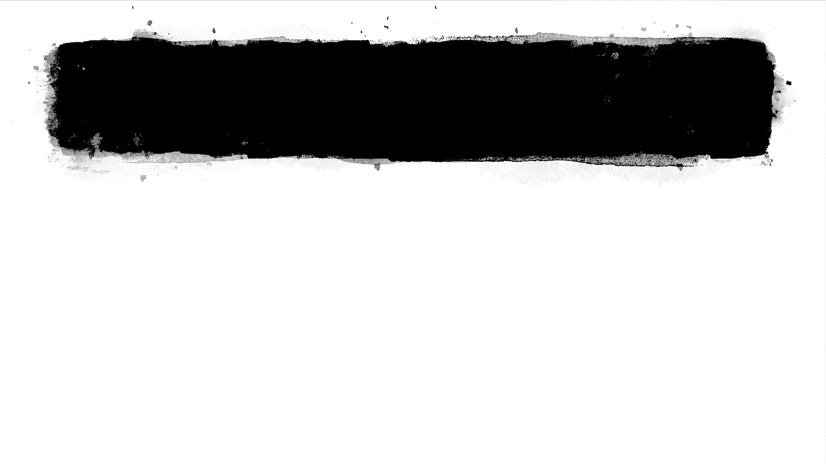
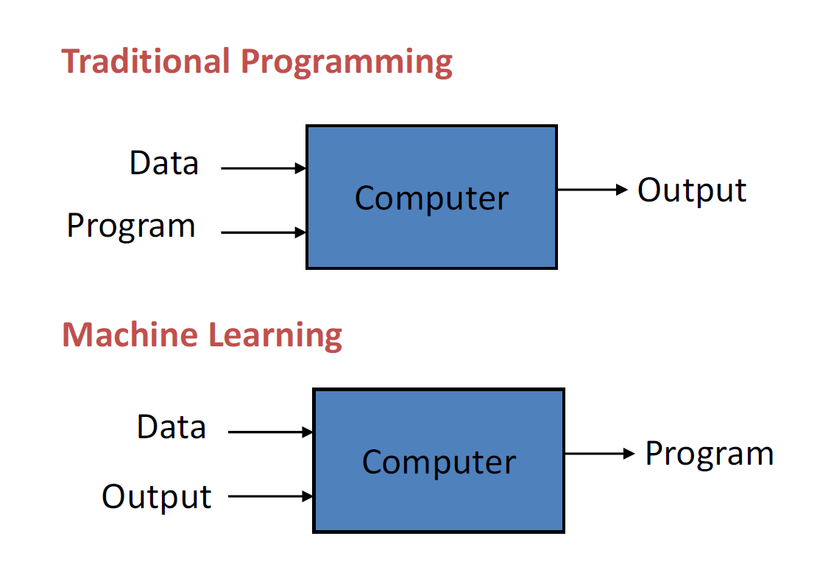
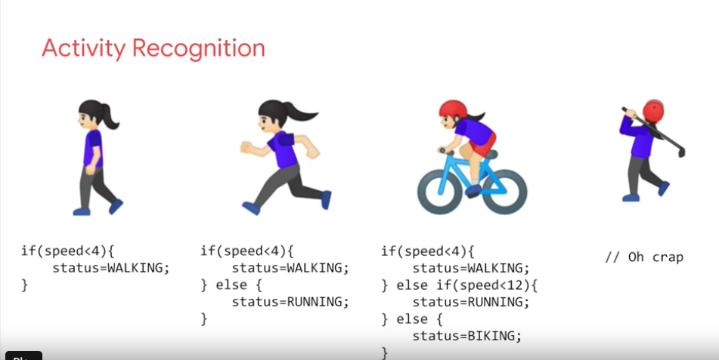
What is Machine Learning?

Slide 6
Sample Applications
Web search
Computational biology
Finance
Space exploration
Robotics
Information extraction
Social networks
Debugging software
E-commerce

Slide 7
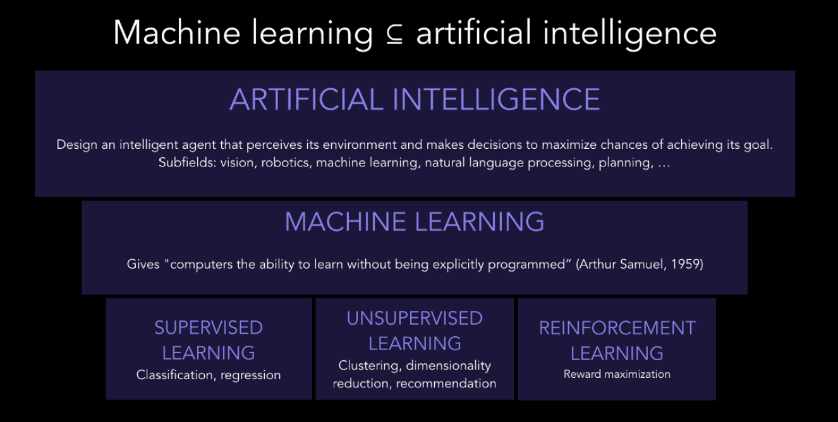

Slide 8
Types Of ML Algorithm
• Supervised (inductive) learning
– Given: training data + desired outputs (labels)
• Unsupervised learning
– Given: training data (without desired outputs)
• Semi-supervised learning
– Given: training data + a few desired outputs
• Reinforcement learning
– Rewards from sequence of actions

Slide 9
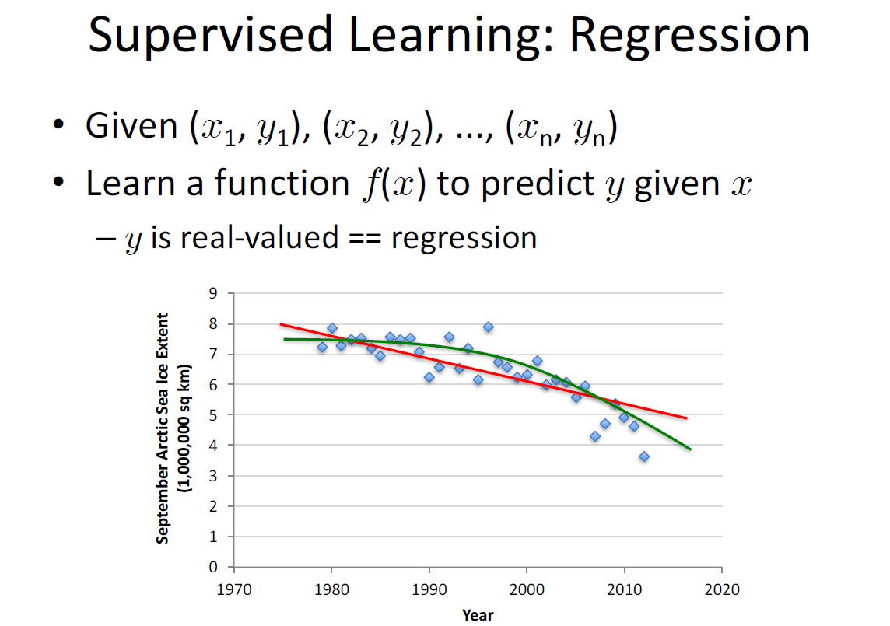

Slide 10
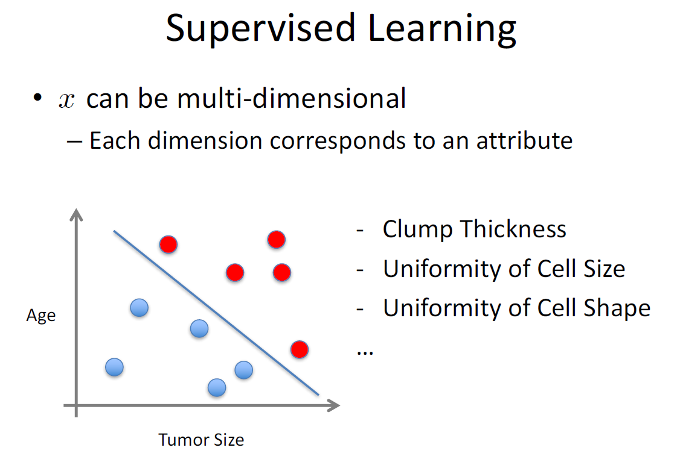

Slide 11
Regression
Linear Regression
Regression is a method of modelling a target value based on independent predictors. This method is mostly used for forecasting and finding out cause and effect relationship between variables.
Regression techniques mostly differ based on the number of independent variables and the type of relationship between the independent and dependent variables.

Slide 12
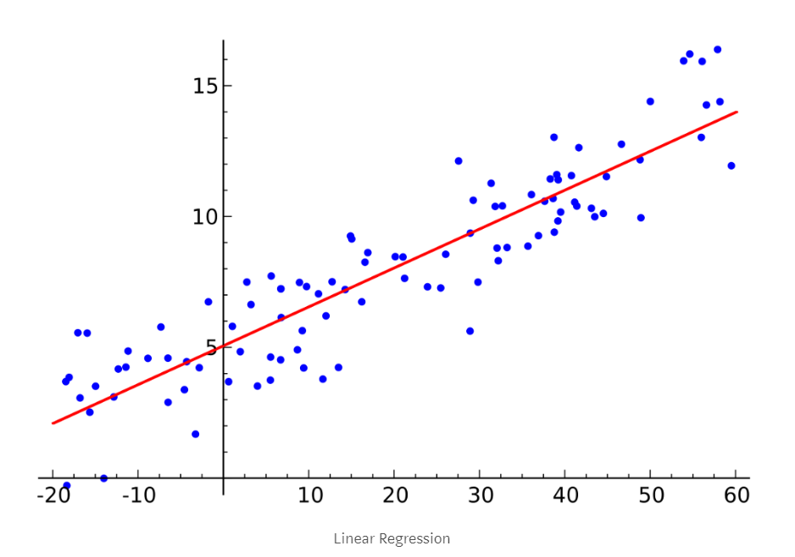

Slide 13
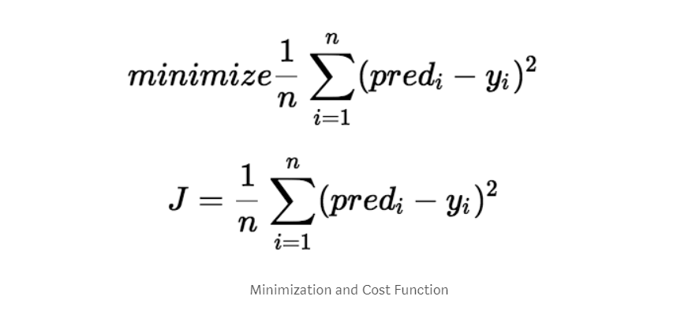
Cost Function
This cost function is also known as the Mean Squared Error(MSE) function.
Now, using this MSE function we are going to change the values of a_0 and a_1 such that the MSE value settles at the minima.

Slide 14
Gradient Decent
Gradient descent is a method of updating a_0 and a_1 to reduce the cost function(MSE). The idea is that we start with some values for a_0 and a_1 and then we change these values iteratively to reduce the cost. Gradient descent helps us on how to change the values.
Notes:
The goal of gradient descent is to find the minimum of our model’s loss function by
iteratively getting a better and better approximation of it.
Imagine yourself walking through a valley with a blindfold on. Your goal is to find the
bottom of the valley. How would you do it?
A reasonable approach would be to touch the ground around you and move in
whichever direction the ground is sloping down most steeply. Take a step and repeat
the same process continually until the ground is flat. Then you know you’ve reached
the bottom of a valley; if you move in any direction from where you are, you’ll end up at
the same elevation or further uphill.

Slide 15
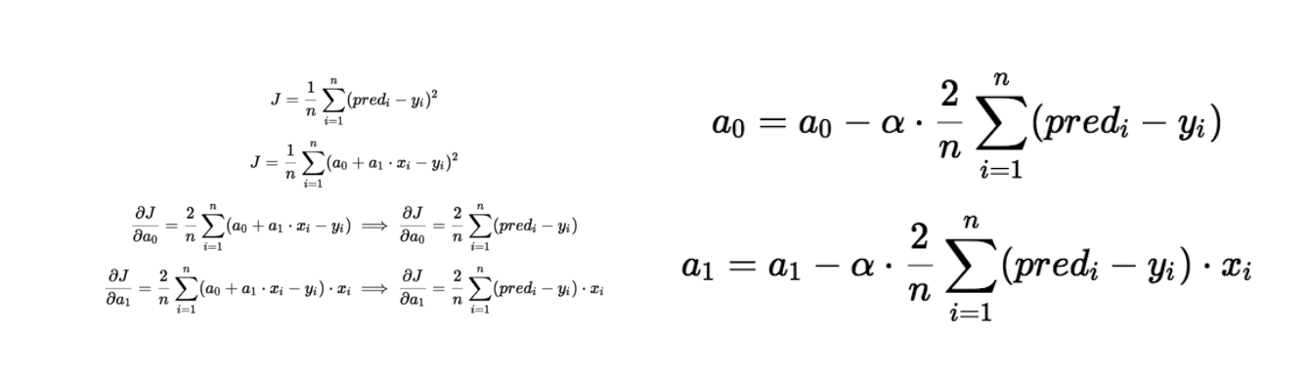
Gradient Decent

Slide 16
Gradient decent
The partial derivates are the gradients and they are used to update the values of a_0 and a_1.
Alpha is the learning rate which is a hyperparameter that you must specify.
A smaller learning rate could get you closer to the minima but takes more time to reach the minima, a larger learning rate converges sooner but there is a chance that you could overshoot the minima.

Slide 17
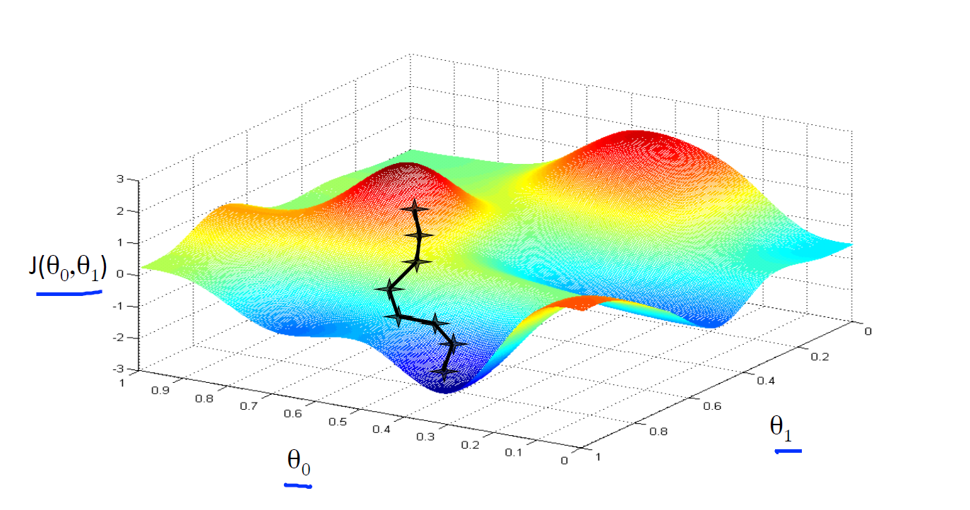
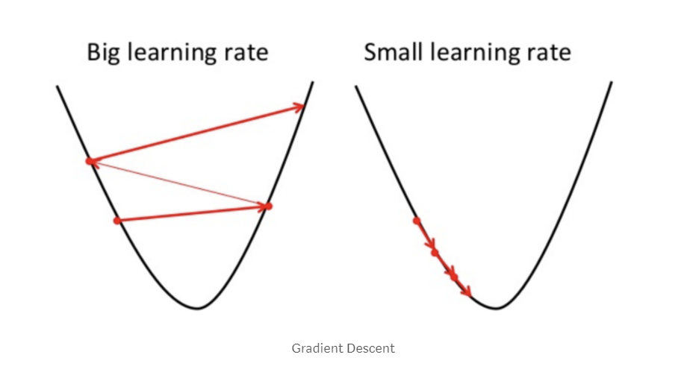
Learning rate ( alpha )

Slide 18
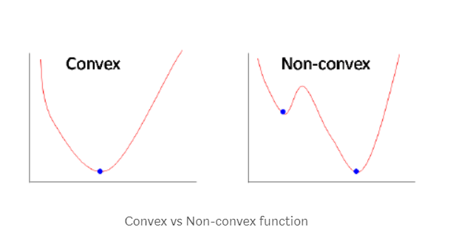
Convex Vs Non-convex
Sometimes the cost function can be a non-convex function where you could settle at a local minima but for linear regression, it is always a convex function.

Slide 19
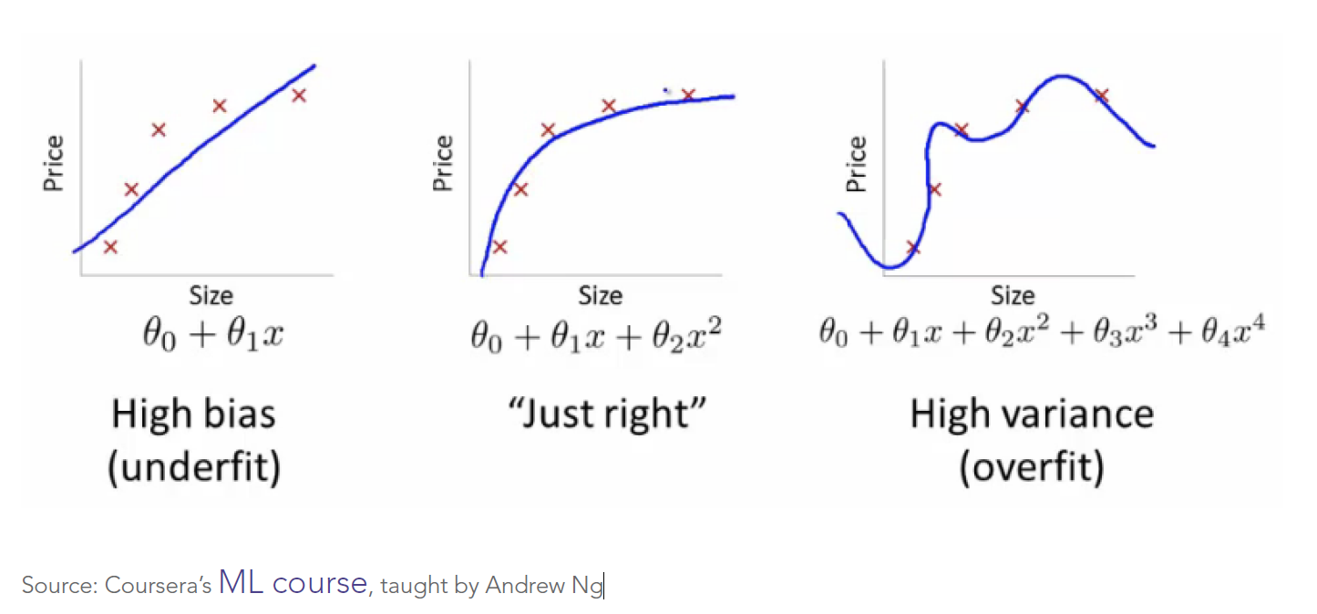
Bias and Variance
Notes:
A common problem in machine learning is overfitting: learning a function that perfectly
explains the training data that the model learned from, but doesn’t generalize well to
unseen test data. Overfitting happens when a model overlearns from the training data
to the point that it starts picking up idiosyncrasies that aren’t representative of patterns
in the real world. This becomes especially problematic as you make your model
increasingly complex. Underfitting is a related issue where your model is not complex
enough to capture the underlying trend in the data.
Bias-Variance Tradeoff
Bias is the amount of error introduced by approximating real-world phenomena with a
simplified model.
Variance is how much your model's test error changes based on variation in the training data. It
reflects the model's sensitivity to the idiosyncrasies of the data set it was trained on.

Slide 20
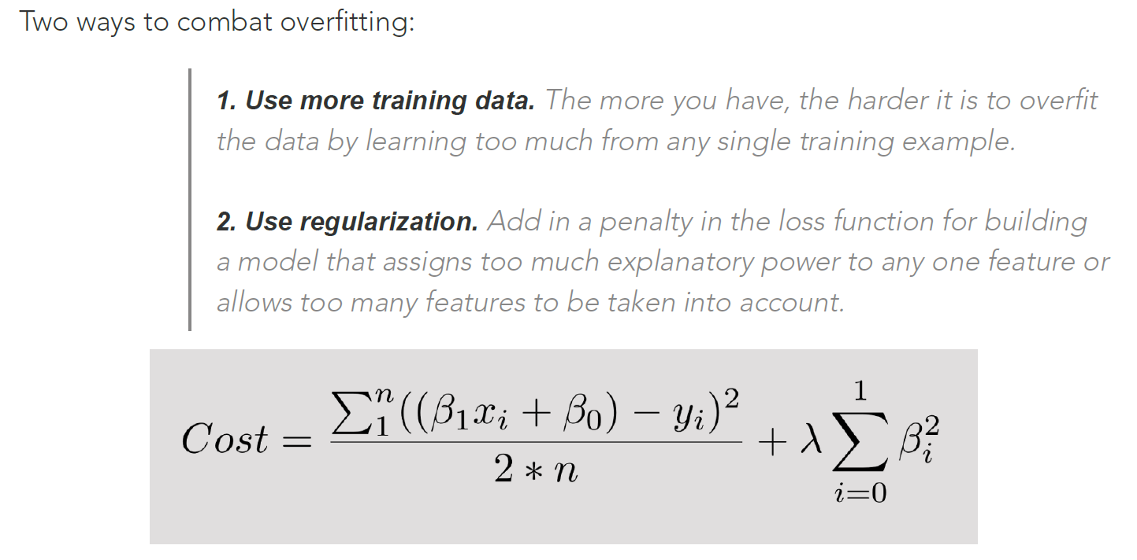
Notes:
The first piece of the sum above is our normal cost function. The second piece is a
regularization term that adds a penalty for large beta coefficients that give too much
explanatory power to any specific feature. With these two elements in place, the
cost function now balances between two priorities: explaining the training data and
preventing that explanation from becoming overly specific.
The lambda coefficient of the regularization term in the cost function is a
hyperparameter: a general setting of your model that can be increased or decreased
(i.e. tuned) in order to improve performance. A higher lambda value will more harshly
penalize large beta coefficients that could lead to potential overfitting. To decide
the best value of lambda, you’d use a method called cross-validation which involves
holding out a portion of the training data during training, and then seeing how well
your model explains the held-out portion.

Slide 21
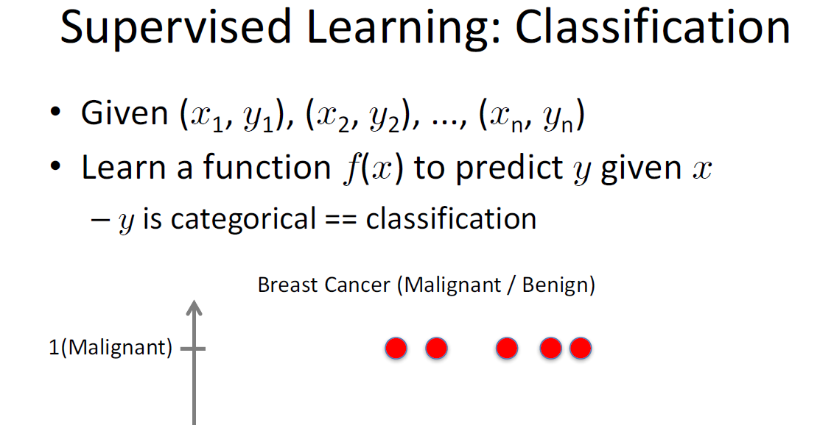

Slide 22
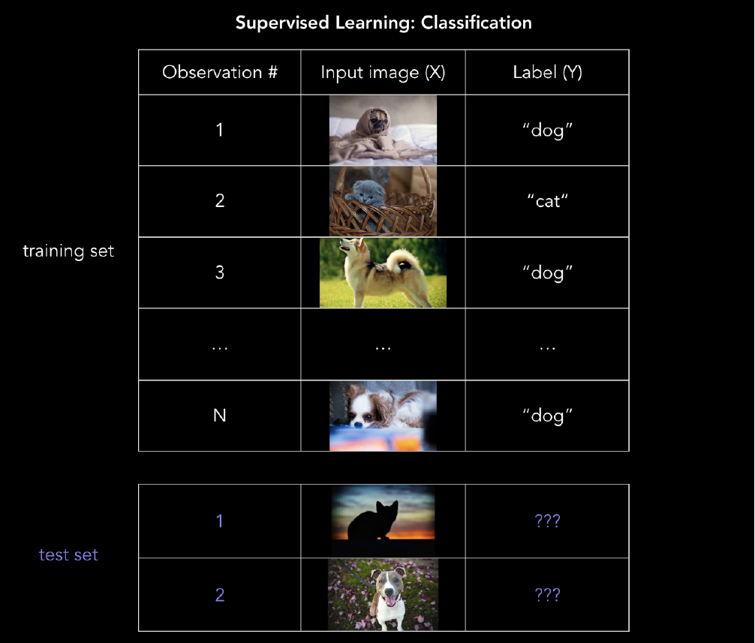
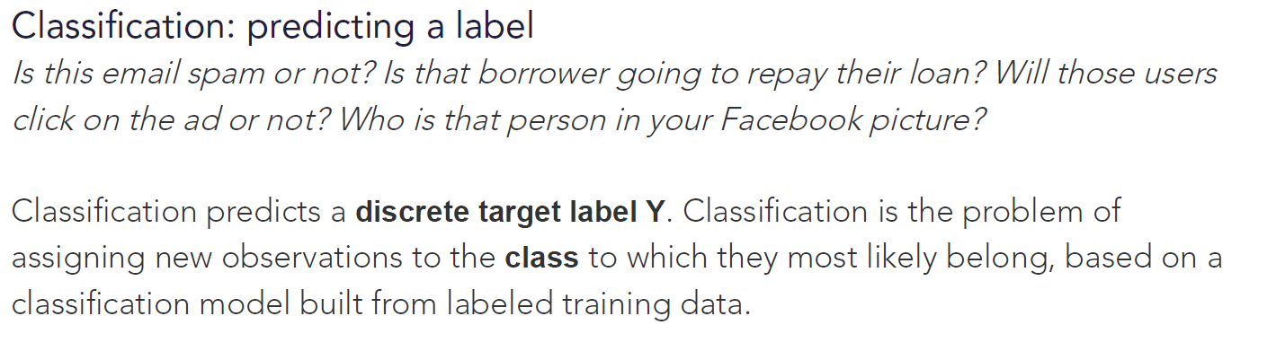
Classification

Slide 23
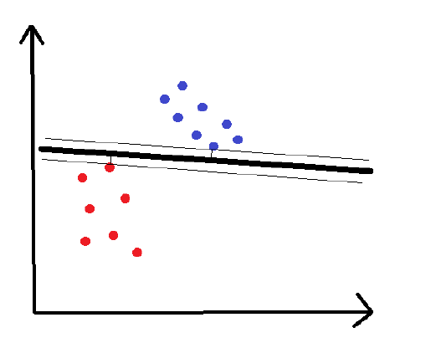
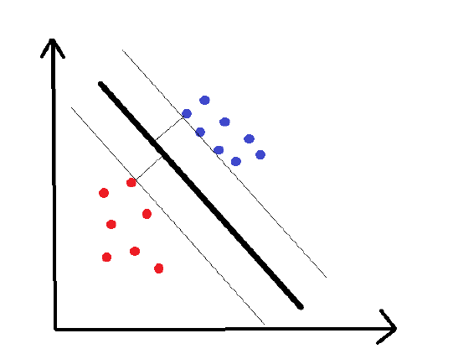
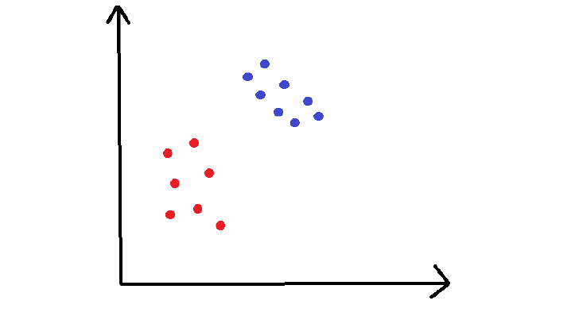
Support vector machines (SVMs)
Notes:
In this example, we have points in a 2D space that are either red or blue, and we’d like
to cleanly separate the two.
The training set is plotted the graph above. We would like to classify new, unclassified
points in this plane. To do this, SVMs use a separating line (or, in more than two
dimensions, a multi-dimensional hyperplane) to split the space into a red zone and a blue zone.
The distance to the nearest point on either side of the line is called the margin, and SVM tries to maximize
the margin. You can think about it like a safety space: the bigger that space, the less
likely that noisy points get misclassified.

Slide 24
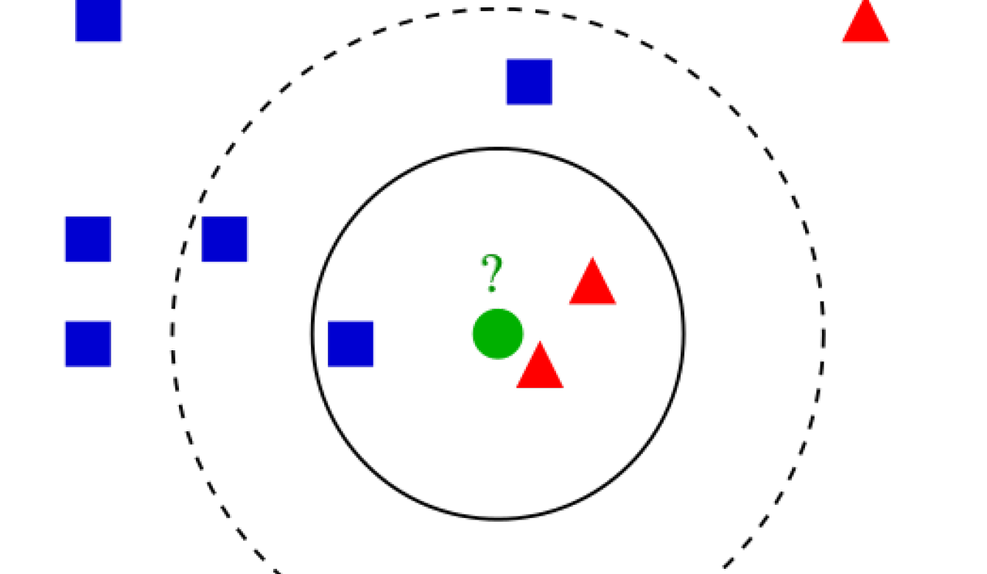
k-nearest neighbors (k-NN)
“You are the average of your k closest friends.”
k-NN seems almost too simple to be a machine learning algorithm. The idea is to label a test data point x by finding the mean (or mode) of the k closest data points’ labels
Notes:
You look at the k closest data points and take the
average of their values if variables are continuous (like housing prices), or the mode if
they’re categorical (like cat vs. dog).
If you wanted to guess unknown house prices, you could just take the average of
some number of geographically nearby houses, and you’d end up with some pretty
nice guesses..
The fact that k-NN doesn’t require a pre-defined parametric function f(X) relating Y
to X makes it well-suited for situations where the relationship is too complex to be
expressed with a simple linear model.
To decide which value of k to use, you can test different k-NN models using different values of
k with cross-validation.
Higher k prevents overfitting
Higher values of k help address overfitting, but if the value of k is too high your model
will be very biased and inflexible. To take an extreme example: if k = N (the total
number of data points), the model would just dumbly blanket-classify all the test data
as the mean or mode of the training data.
Where to use k-NN in the real world
Classification: fraud detection. The model can update virtually instantly with new
training examples since you’re just storing more data points, which allows quick
adaptation to new methods of fraud.
• Regression: predicting housing prices. In housing price prediction, literally being
a “near neighbor” is actually a good indicator of being similar in price. k-NN is
useful in domains where physical proximity matters.
• Imputing missing training data. If one of the columns in your .csv has lots of
missing values, you can impute the data by taking the mean or mode. k-NN
could give you a somewhat more accurate guess at each missing value.

Slide 25
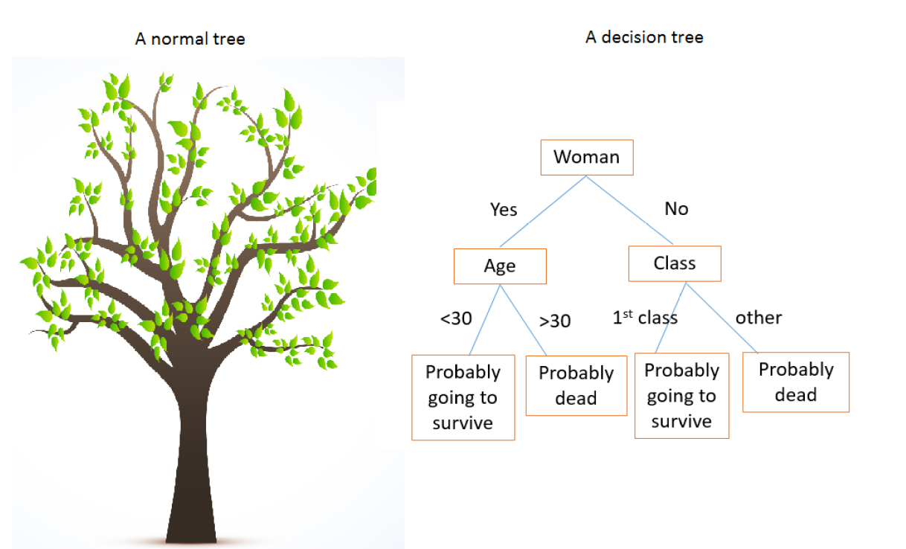
Decision trees, random forests
Notes:
possible split of the training data and maximize information gain for every split. This
way you can predict every label or value as efficiently as possible.
Now, let’s look at a particular data set and talk about how we choose splits.
The Titanic dataset
Kaggle has a Titanic dataset that is used for a lot of machine learning intros. When the
titanic sunk, 1,502 out of 2,224 passengers and crew were killed. Even though there was
some luck involved, women, children, and the upper-class were more likely to survive.
If you look back at the decision tree above, you’ll see that it somewhat reflects this
variability across gender, age, and class.
Decision trees are effective because they are easy to read, powerful even with messy
data, and computationally cheap to deploy once after training. Decision trees are also
good for handling mixed data (numerical or categorical).
That said, decision trees are computationally expensive to train, carry a big risk of
overfitting, and tend to find local optima because they can’t go back after they have
made a split. To address these weaknesses, we turn to a method that illustrates the
power of combining many decision trees into one model.
Random forest: an ensemble of decision trees
A model comprised of many models is called an ensemble model, and this is usually a
winning strategy.
A single decision tree can make a lot of wrong calls because it has very black-and-white
judgments. A random forest is a meta-estimator that aggregates many decision trees,
with some helpful modifications.

Slide 26
Bias and Variance
In supervised learning, underfitting happens when a model unable to capture the underlying pattern of the data. These models usually have high bias and low variance. It happens when we have very less amount of data to build an accurate model or when we try to build a linear model with a nonlinear data.
In supervised learning, overfitting happens when our model captures the noise along with the underlying pattern in data. It happens when we train our model a lot over noisy dataset.

Slide 27
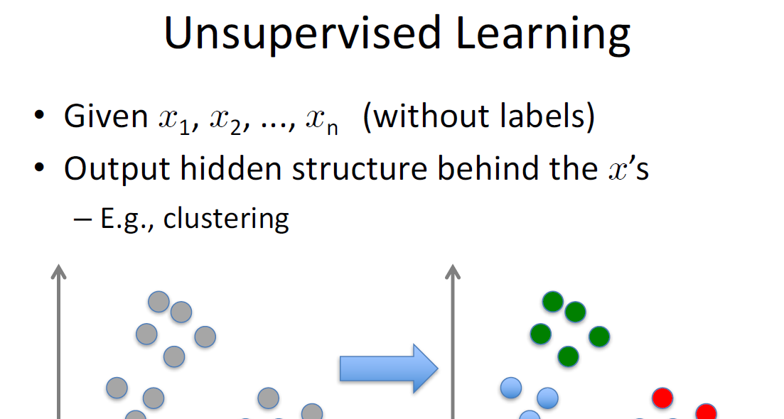

Slide 28
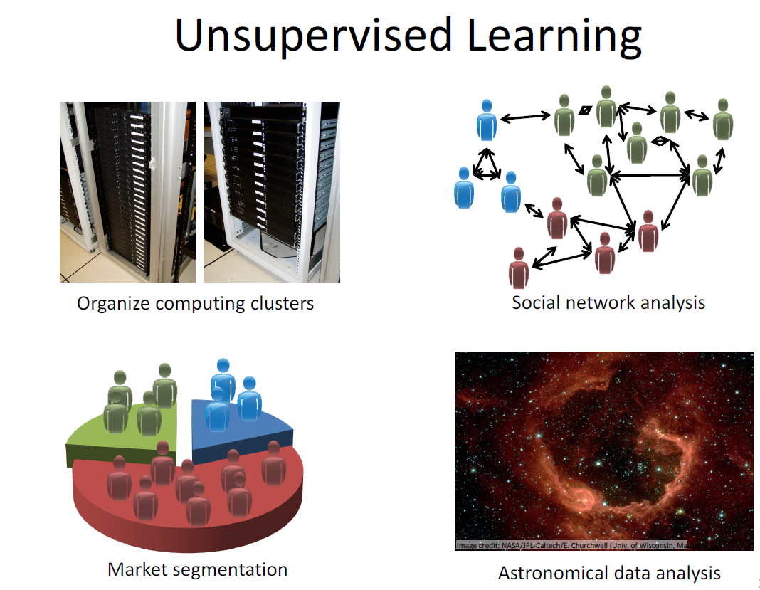
Notes:
Clustering and dimensionality reduction: k-means clustering, hierarchical clustering,
principal component analysis (PCA), singular value decomposition (SVD)

Slide 29
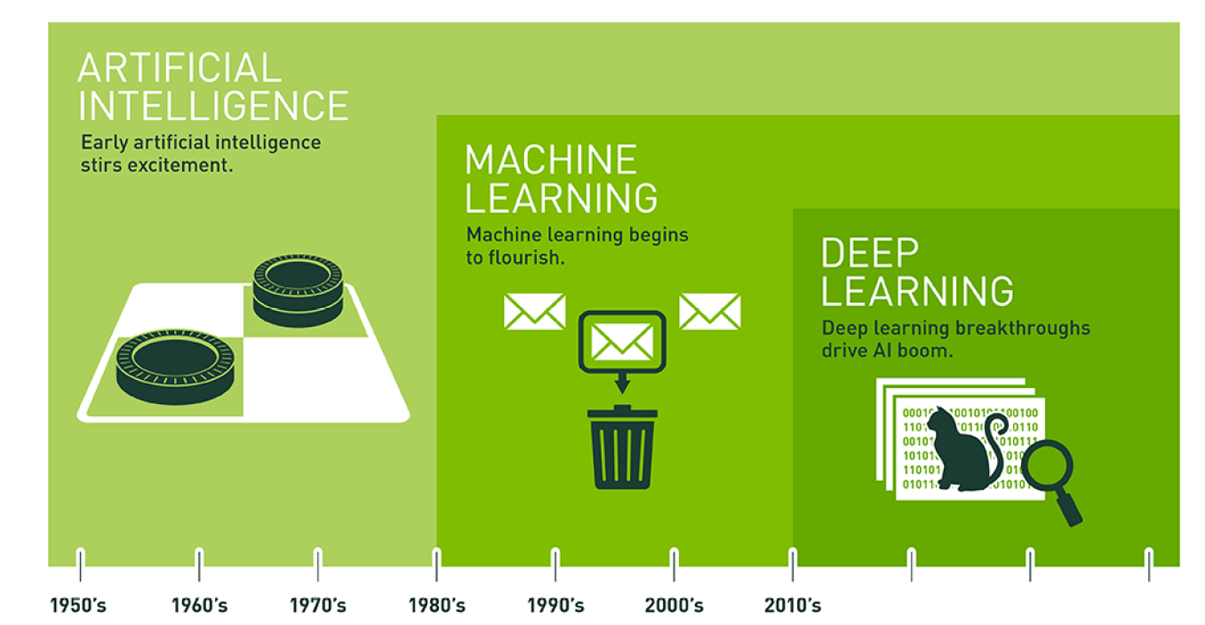
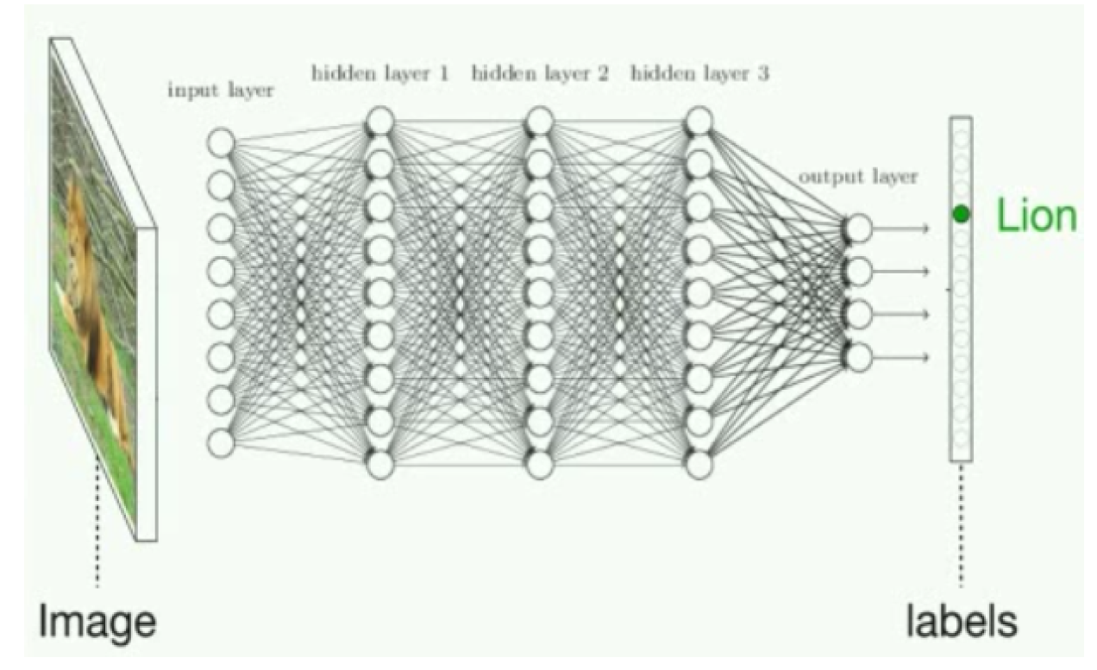
Neural Networks & Deep Learning

Slide 30
Neural Networks….
Notes:
Brains are made up of neurons which “fire” by emitting electrical signals to other
neurons after being sufficiently “activated”. These neurons are malleable in terms of
how much a signal from other neurons will add to the activation level of the neuron
(vaguely speaking, the weights connecting neurons to each other end up being
trained to make the neural connections more useful, just like the parameters in a linear
regression can be trained to improve the mapping from input to output).

Slide 31
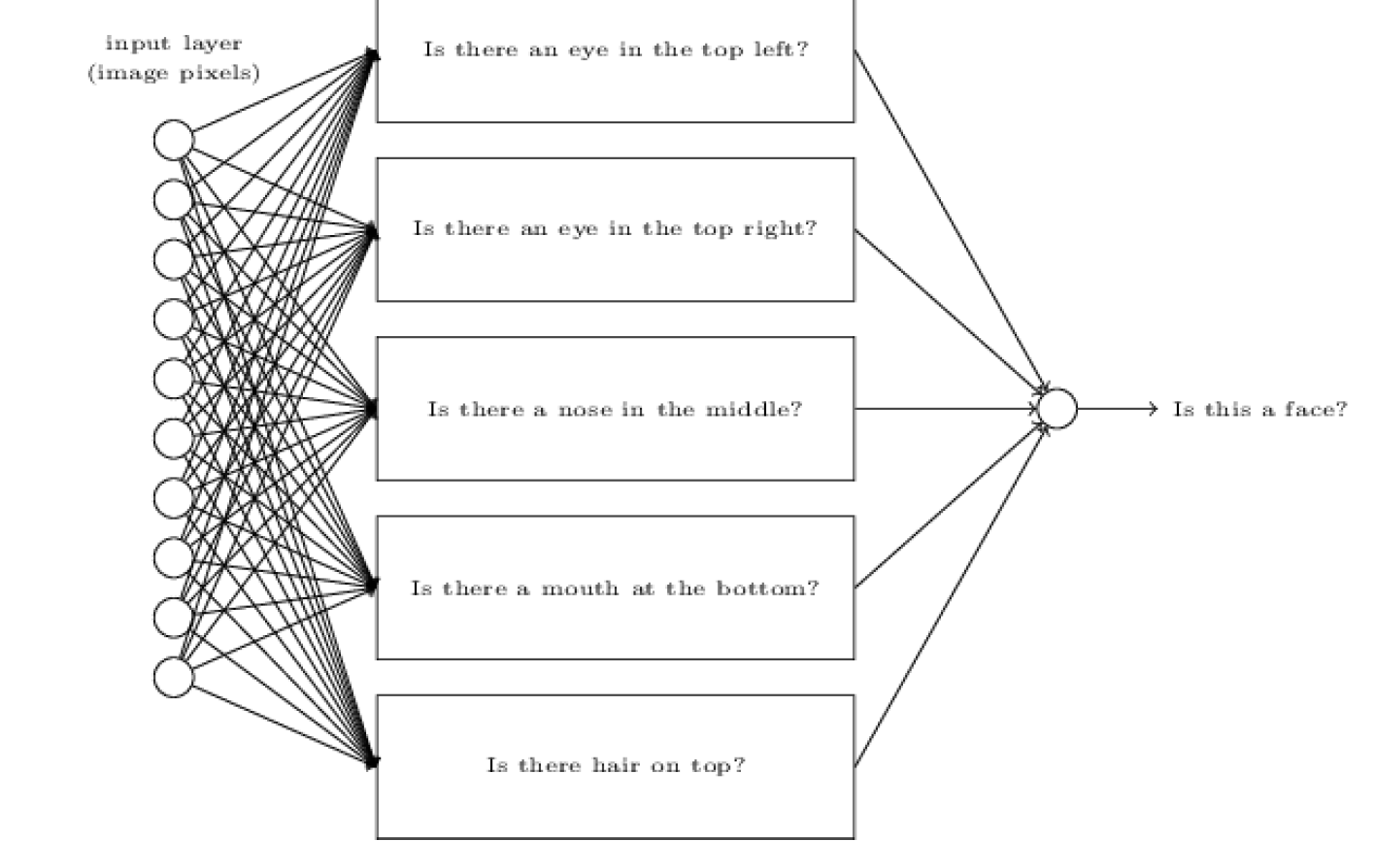
Deep Learning
Notes:
Deep neural networks approach the image classification problem using
layers of abstraction
To repeat what we explained earlier in this section: the input layer will take raw pixel
brightnesses of an image. The final layer will be an output vector of class probabilities
(i.e. the probability of the image being a “cat”, “car”, “horse”, etc.)
But instead of learning a simple linear model relating input to output, we’ll instead
construct intermediate hidden layers of the network will learn increasingly abstract
features, which enables us to not lose all the nuance in the complex data
Just as we described animal brains detecting abstract features, the artificial neurons
in the hidden layers will learn to detect abstract concepts — whichever concepts
are ultimately most useful for capturing the most information and minimizing loss
in the accuracy of the network’s output.

Slide 32
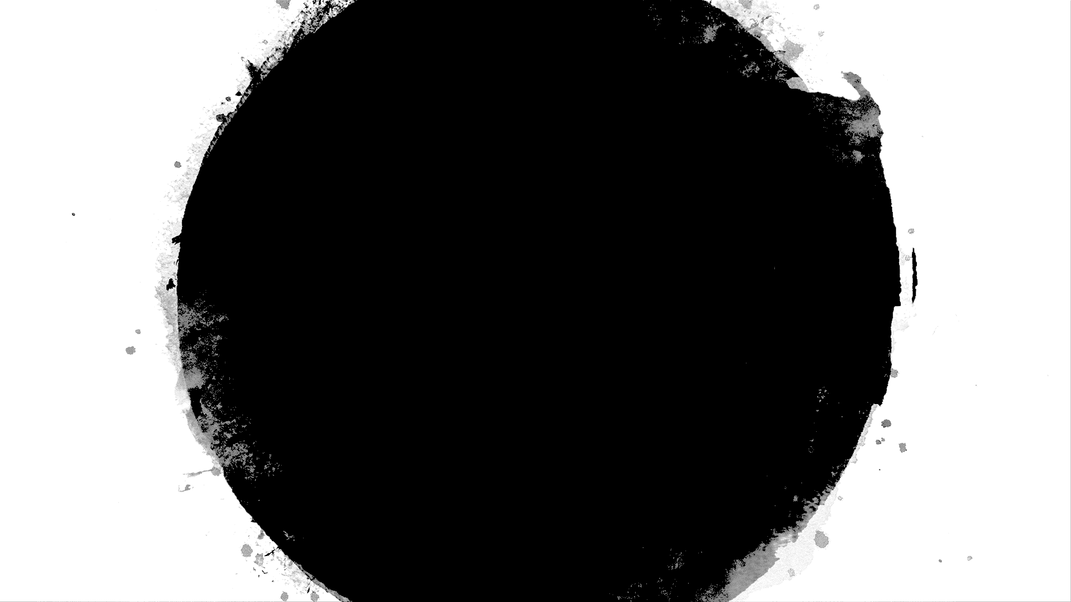
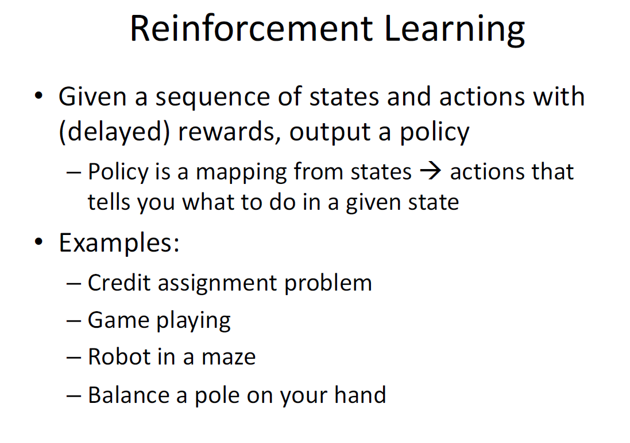

Slide 33
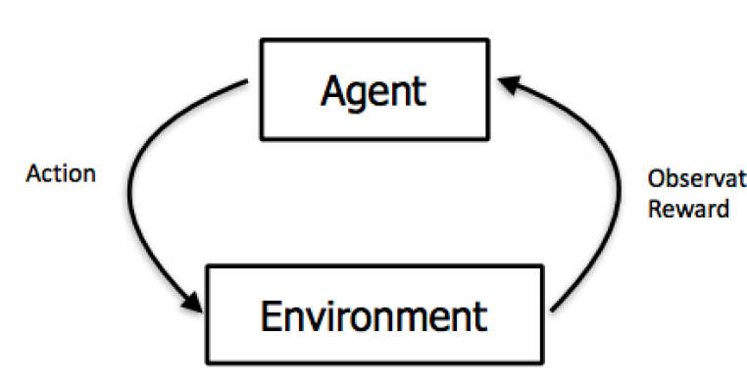
Notes:
the epsilon-greedy strategy, where epsilon is the percent of the
time that the agent takes a randomly selected action rather than taking the action that
is most likely to maximize reward given what it knows so far (in this case, 20%). We
usually start with a lot of exploration (i.e. a higher value for epsilon). Over time, as the
mouse learns more about the maze and which actions yield the most long-term reward,
it would make sense to steadily reduce epsilon to 10% or even lower as it settles into
exploiting what it knows.
It’s important to keep in mind that the reward is not always immediate:

Slide 34
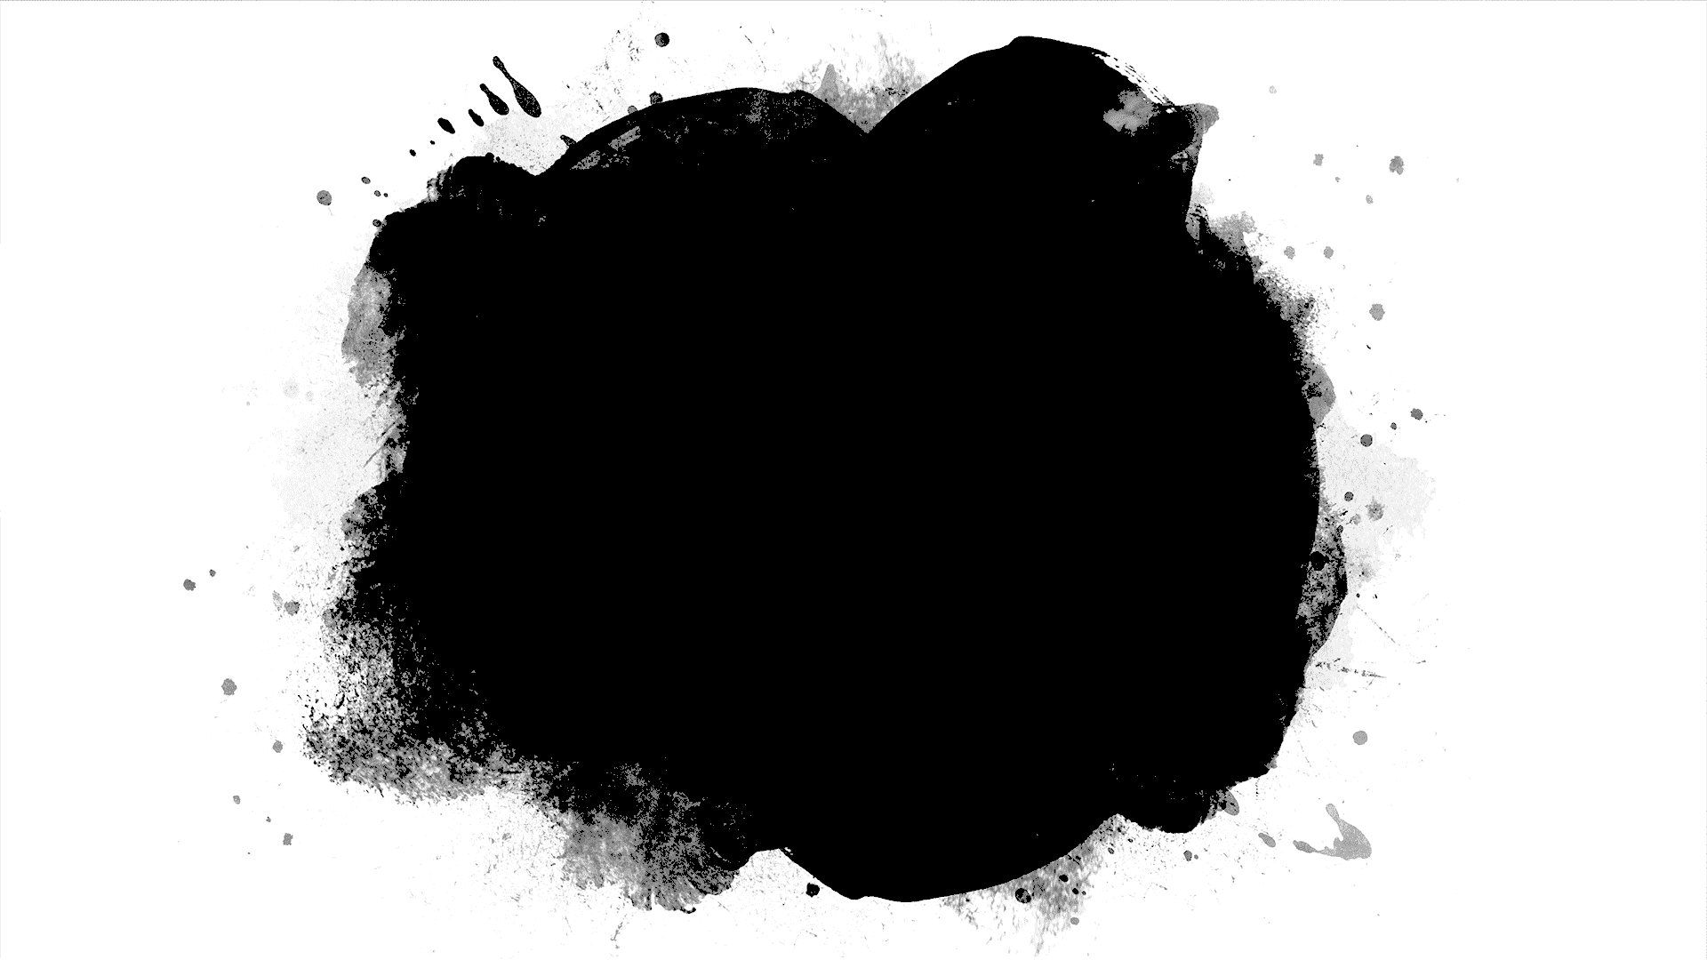
Questions ?

Slide 35
Lets see the code
Linear Regression
Suppose you are the CEO of a restaurant franchise and are considering different cities for opening a new outlet. The chain already has trucks in various cities and you have data for profits and populations from the cities.
You would like to use this data to help you select which city to expand to next.

